Slide 1
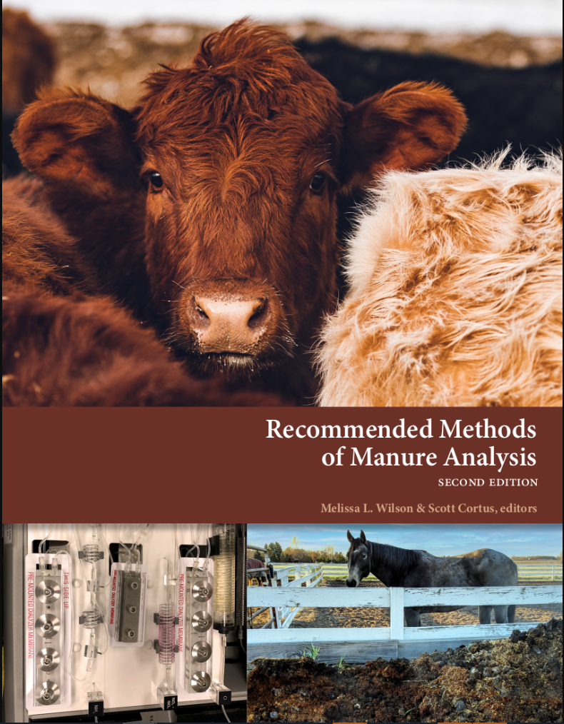
Recommended Methods of Manure Analysis
Kristin Hicks
North Carolina Dept. of Agriculture

Slide 2
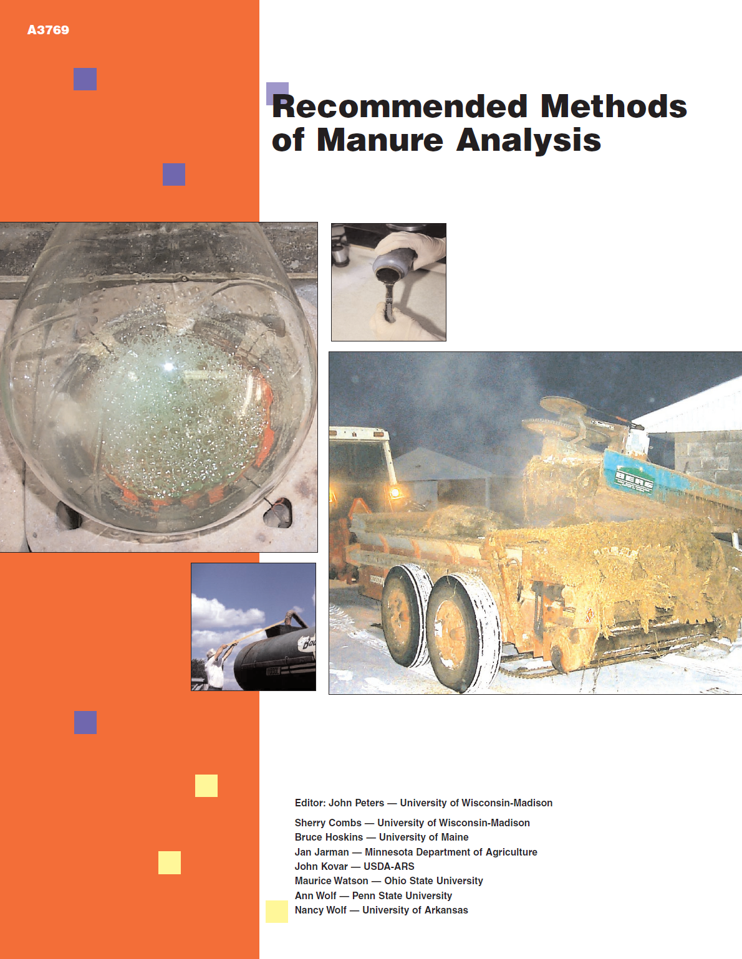
A bit of history
Original methods manual started with a working group in 1996
John Kovar, Ann Wolf, Nancy Wolf, Jan Jarman, Bruce Hoskins, Sherry Combs, Maurice Watson, John Peters (ed.)
Published in 2003 by University of Wisconsin Extension

Slide 3



Started by Melissa Wilson (UMN)
Found funding
Time for a new update
Notes:
Original team consisted of Bob Miller, Kristin Hicks, John Spargo, Brian Thayer, Jerry Floren, Jeff Porter, Rachel Brimmer, and Larry Gunderson. Brought on Jay Lessl, Fred Vocasek, Rob Meinen, Jake Mowrer, and Tim Hoerner to round out the various methods. Peer reviewers were Patrick Visser, John Breker, John Kovar, and Peter Kleinman.

Slide 4
Lead by Melissa Wilson (UMN)
Assembled a team
Time for a new update
Developed a template and wrote up the methods
Peer review
Copy editing
Notes:
Original team consisted of Bob Miller, Kristin Hicks, John Spargo, Brian Thayer, Jerry Floren, Jeff Porter, Rachel Brimmer, and Larry Gunderson. Brought on Jay Lessl, Fred Vocasek, Rob Meinen, Jake Mowrer, and Tim Hoerner to round out the various methods. Peer reviewers were Patrick Visser, John Breker, John Kovar, and Peter Kleinman.

Slide 5
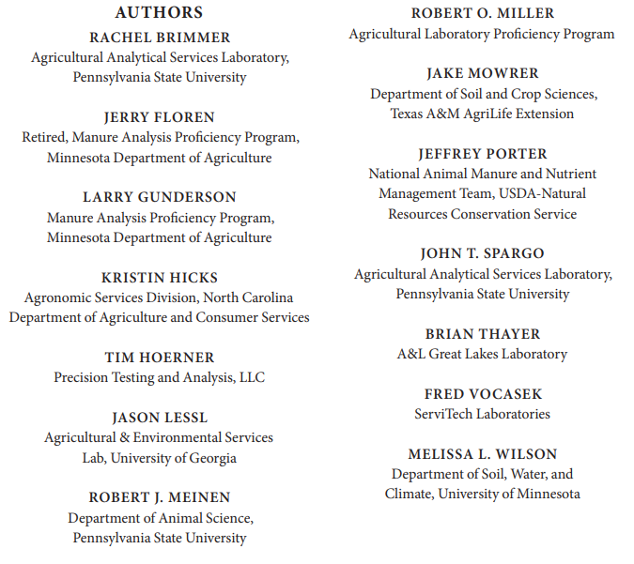
Manual Primary Authors

Slide 6
Developed a template and wrote up the methods
Time for a new update
Peer review
Copy editing
Notes:
We adopted the UC Davis template early on but we may a number of changes to it. I’d like to say it was fairly straightforward but we spent a considerable amount of time discussing what should go in each section and we made a number of changes to the structure.

Slide 7
Goals of the Authors
  Share historical, regional meta-data on average nutrient concentrations in manure
  Standardize procedures for field and lab sampling
  Create detailed, consistent, stand-alone guides for modern methods
    Update equipment and other aspects of earlier methods
    Write methods for new methods in use
    Include quality control components and performance criteria
    Provide definitions and conversion factors
  Guide labs on lab quality management
  Educate about the MAP program and how to interpret results
  Provide guidance on how to create client reports

Slide 8
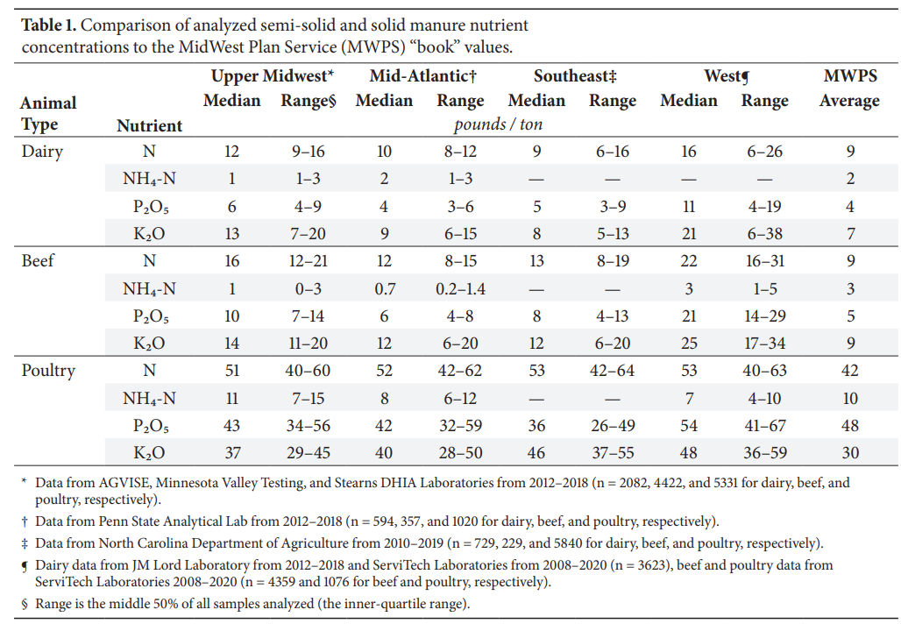
Introduction
Melissa Wilson
Upper Midwest, Mid-Atlantic, Southeast and West
N, P, K, NH4
Liquid, slurry solids
Dairy, beef, poultry, swine

Slide 9
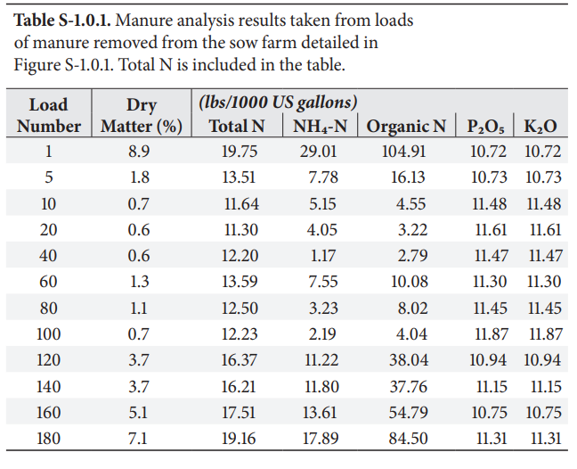
Manure Sampling in the Field
Rob Meinen
Timing
Composite sampling
Collection before and during application
Handling and shipping

Slide 10
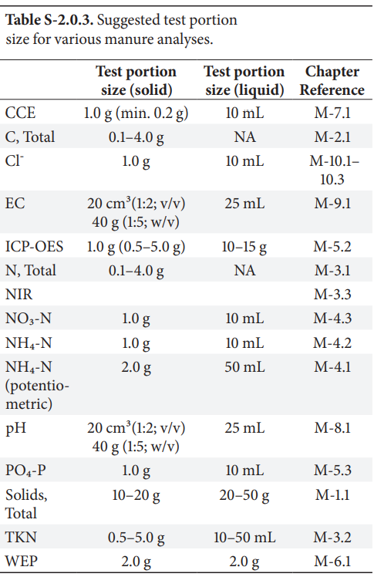
Laboratory Sample Processing & Storage
Kristin Hicks, Tim Hoerner, and John T. Spargo
Biohazards and Laboratory Safety
Receiving, examination, and transfer
Preservation & storage time by analyte
Homogenization
  Liquids & slurries
  Solids & semi-solids
Subsampling & test portion
Notes:
Such an important component of quality control but often overlooked in methods
You can’t really control what happens in the field but once that sample is in your lab you are responsible for ensuring that the results you report accurately reflects what was in that sample when it arrived. And this is step 1 and the most difficult to prevent errors.
Preservation and storage:
Relied on EPA and Standard methods for the examination of water and waste water primarily but these sometimes contradicted each other and were not based on manure. Very little in the literature. Required a lot of discussion
Homogenization: Very little in literature. much discussion and lab testing. Handy picture of devices.
Test portion: Summarized here and also in each method chapter

Slide 11
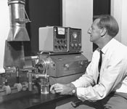
Methods Changes from 2003 Manual
Removed
Added
Atomic Absorption Spectroscopy
Total & Volatile Solids
Total Carbon
NIR
NH4-N by Diffusion-Conductivity
NO3-N
Water Extractable P
CCE
Chloride by Spectrophotometry, Coulometry and Potentiometry
Alan Walsh developed the technique of atomic absorption spectroscopy in 1952. CSIRO

Slide 12
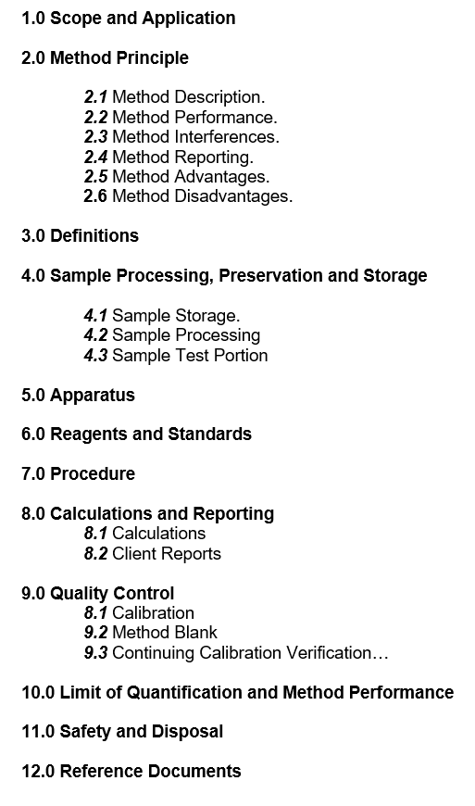
Method Template
Started with UC Davis California Analytical Methods Manual form
Made several changes
QC section expanded; consistent terminology, appropriate statistic, acceptance criteria, corrective action
LOQ & MP includes precision data from MAP

Slide 13
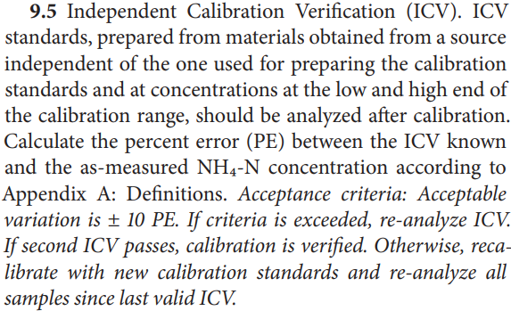
QC Component Example

Slide 14
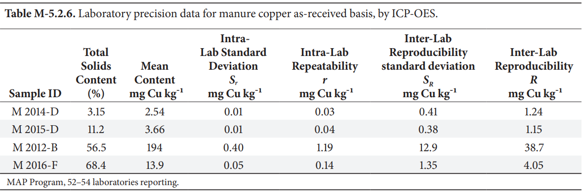
Method Performance Example

Slide 15
Methods
NEW
Total & Volatile Solids
Carbon, Total by Combustion
Nitrogen, Total by Combustion
Total Kjeldahl Nitrogen (TKN) Method
Nitrogen, Total by Near-Infrared Spectroscopy (NIR) for Poultry Litter
Nitrogen, Ammonium (NH4-N) by Ion-Selective Electrode (Potentiometric)
Nitrogen, Ammonium (NH4-N) by Distillation, Spectrophotometry, and Diffusion-Conductivity
Nitrogen, Nitrate by Cadmium or Hydrazine Reduction; Automated Spectrophotometry
Digestion & Dissolution for Elemental Analysis
Phosphorus, Potassium, & Metals by ICP-OES
Phosphorus by Automated Spectrophotometry
Water Extractable Phosphorus, 100:1 solution to solids ratio
Calcium Carbonate Equivalent (CCE)
pH
Electrical Conductivity (EC)
Chloride by Spectrophotometry
Chloride by Coulometry
Chloride by Potentiometry

Slide 16
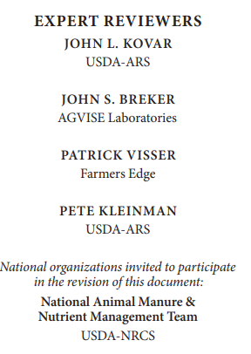
Author & Peer Review
Methods divided among authors for first draft
1st draft reviewed by second author
2nd draft edited by third author
Dr. Wilson invited expert reviewers to evaluate 3rd draft. Two reviewers per method.
Authors assigned method sections and made consistency edits to all methods. Back to first author made final review
Copy editor and back to first author for approval

Slide 17
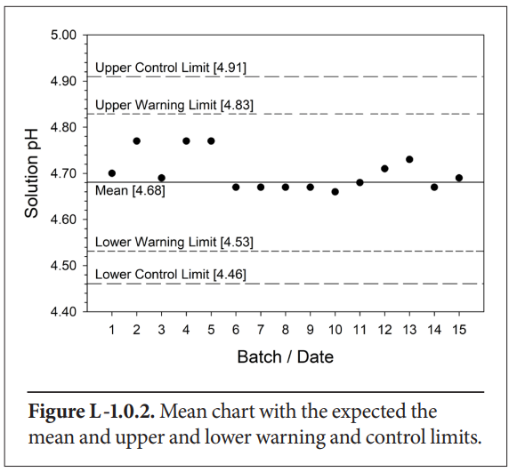
Laboratory Quality Management
Bob Miller & John Spargo
Standard Operating Procedures
Method and Instrument Logs
QC Definitions: Error, Accuracy, Precision, Bias, and Uncertainty
Statistics
QC Analytical Practices (MDL, CB, ICV, CCV, RM, MSR)
Method Validation
QC Statistical Control Charts
External QC
Reporting
Notes:
Includes sources of error and solutions

Slide 18
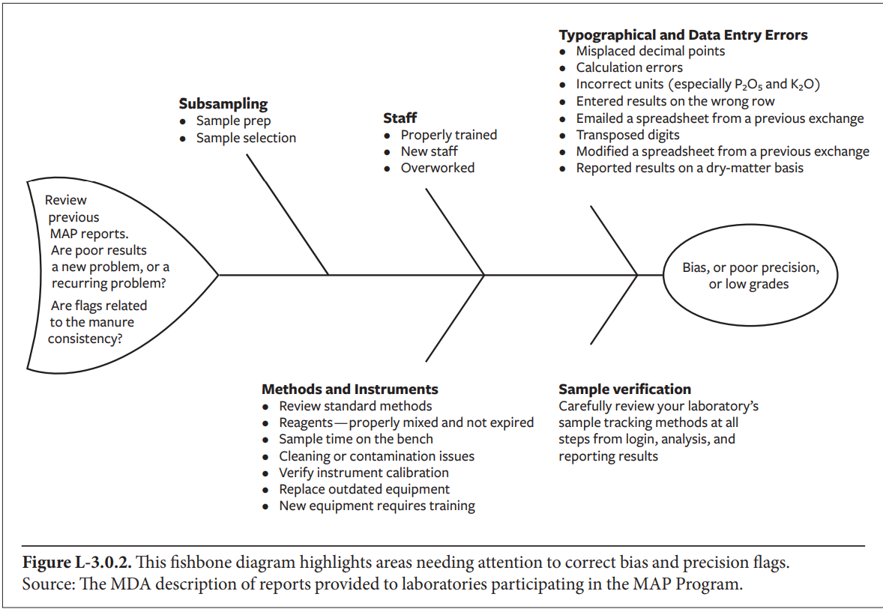
MAP Chapters
Jerry Floren, Robert Miller, and Larry Gunderson
The Manure Analysis Proficiency (MAP) Program
Evaluating Laboratory Performance

Slide 19
Reporting Results
Jerry Floren, Fred Vocasek, John T. Spargo, and Jeff Porter
Legal Requirements and Voluntary Programs
Collecting Information from Clients
Creating Customer Reports
Tips for Successful Reports
Example Reports

Slide 20
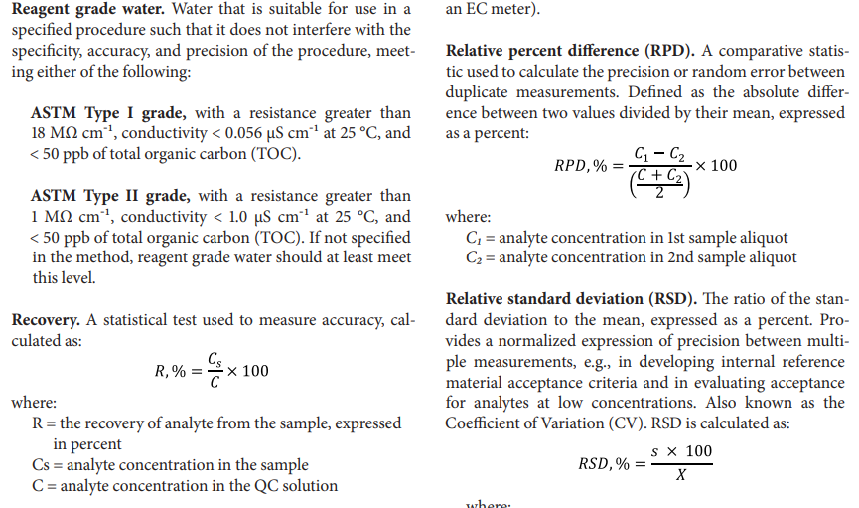
APPENDIX A Common definitions and conversions
APPENDIX B Procedure for the Determination of the Method Detection Limit (MDL)

Slide 21
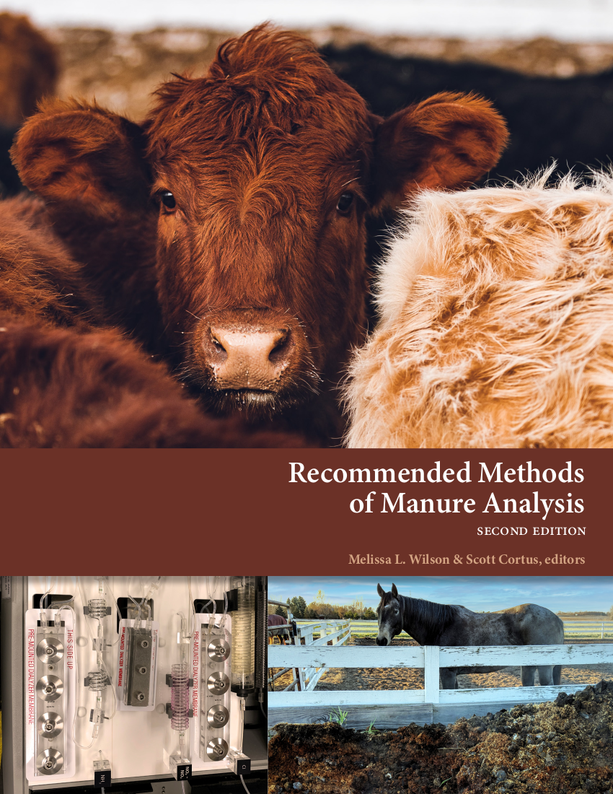

The final product
Available electronically at: https://z.umn.edu/Manure-analysis-methods
Printed copies will hopefully be on sale in near future

